Slide 1

Structural Variation Detection and Interpretation
Eugene Gardner
Postdoctoral Fellow
Wellcome Sanger Institute
@DrGeneUK
E: eg15@sanger.ac.uk
Presentation originally developed by:
Thomas Keane
EVA, EGA, ENA archive infrastructure team
EMBL-EBI

Slide 2
Human Genetic Variation
Variation class | Size | # of polymorphic sites per human
Single nucleotide variant (SNV) | 1 bp | 3.53M – 4.31M
Small insertions and deletions (InDels) | 1 – 50 bp | 546k – 625k
Structural Variants (SVs) | >50 bp – 1 Mbp+ | 2.5k – 3.2k
Copy Number Variants (CNVs) Insertions (incl. Mobile Element Insertions) Inversions Translocations |  | 4.8k 2.6k 14 <1
SNP
INDEL
SV (>50 bp)
Reference
GATGCCTTCAT
GATGCCTTCAT
GATGCATTCAT
GAT TTCAT
C/A
GCC/-
Collins, R. L. et al. A structural variant reference for medical and population genetics. (2020). Nature. PMID: 32461652.
1000 Genomes Project Consortium. A global reference for human genetic variation. (2015). Nature. PMID: 26432245.
Notes:
And I want to start by providing a very high-level view of human genetic variation, just to orient everybody to the particular type of variation that I work on.
Human genetic variation is divided into three basic categories:
Single Nucleotide Variation, or a single base change between the reference and any given individual
Small insertions and deletions, or a small number of bases inserted or deleted in any given individual compared to the reference
And Structural Variation, SV, basically any genome rearrangement larger than 50bp
I study a particular type of SV know as a Mobile Element Insertion, or MEI, which are large insertions in relation to the reference caused by autonomous DNA elements known as transposons.
Compared to SNVs, where any given individual has millions of sites in their genome, the average individual has approximately one thousand polymorphic MEI sites, so were dealing with a whole different scale of discovery.

Slide 3
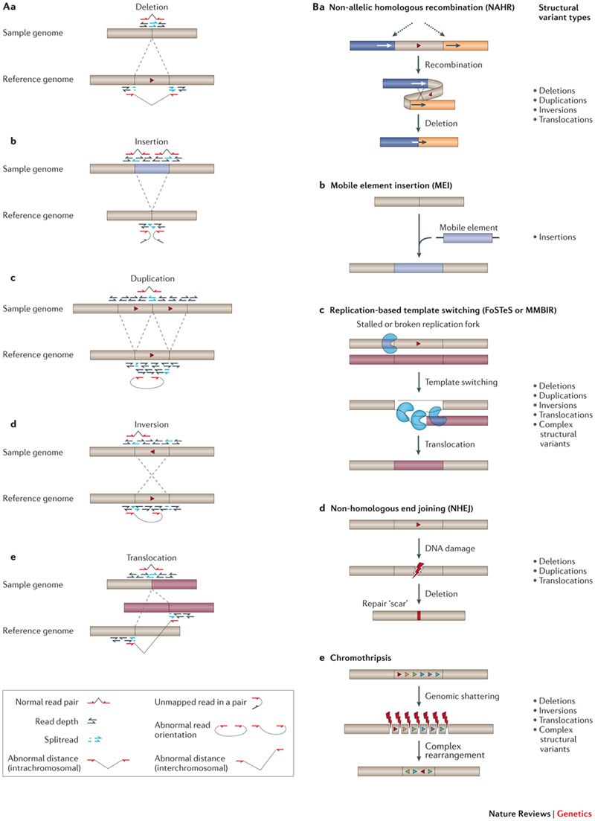
Structural Variant Types
Weischenfeldt J. et al. Phenotypic impact of genomic structural variation: insights from and for human disease. (2013). Nature Reviews Genetics. PMID: 23329113.

Slide 4
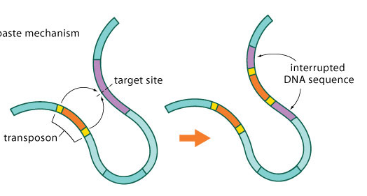
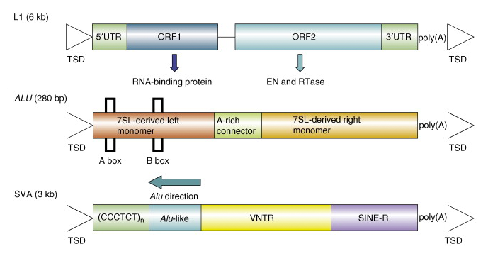
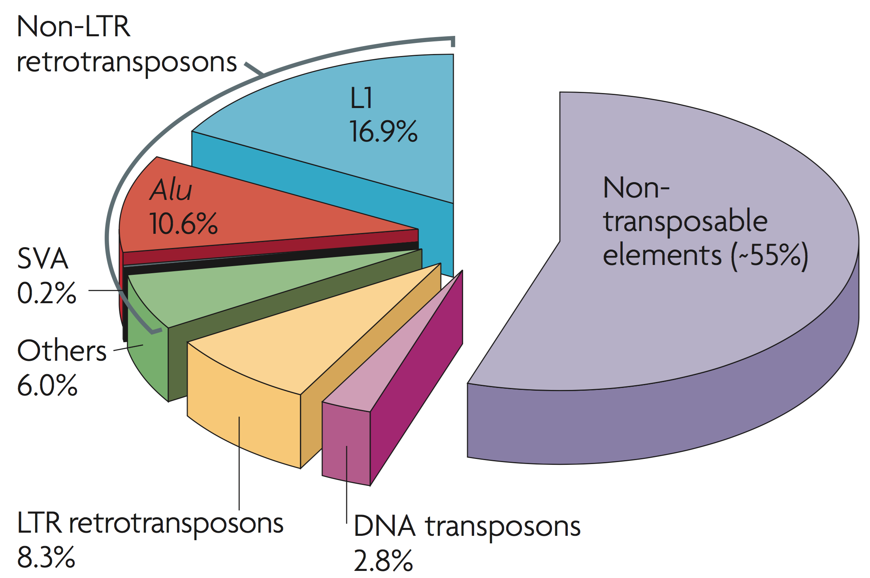
Retrotransposition
Mobile Element Insertion
(MEI)
Mobile Element
RNA
L1-6kbp
Alu-300bp
SVA-3kbp
Cordaux, R., & Batzer, M. A. The impact of retrotransposons on human genome evolution. (2009). Nat Rev Genet. PMID: 19763152.
Mills, R. E., Bennett, E. A., Iskow, R. C., et al. Which transposable elements are active in the human genome? (2007). Trends Genet. PMID: 17331616.

Slide 5
Complex SVs
Collins R. L. et al. Defining the diverse spectrum of inversions, complex structural variation, and chromothripsis in the morbid human genome. (2017). Genome Biology. PMID: 28260531

Slide 6
Organisms Are Variable in Their Genetic Variation
SNP
SNP
Reference Genome
SNP
Indv 1
Indv 2
Indv 3
. . .
Indv 10
SNP InDel SNP

Slide 7
Organisms Are Variable in Their Genetic Variation
SNP
SNP
Reference Genome
SNP
Indv 1
Indv 2
Indv 3
. . .
Indv 10
Transposon SNP CNV Repeat InDel SNP
(Deletion)

Slide 8
Methods for detecting SVs
Chromosome banding: chromosomes are prepared from dividing cells, stained, and viewed with a microscope. Large deletions, duplications, and translocations are detected if the banding pattern or chromosome structure is altered.
Fluorescence in situ hybridization (FISH): fluorescent-labeled DNA probes hybridize to metaphase or interphase cells to visualize a locus on a chromosome and determine copy number. FISH can determine the location of chromosomal segments identified by microarray, NGS, and WGS.
Microarray: array comparative genome hybridisation (array CGH) detects copy-number differences between abnormal and reference genomes. SNP arrays detect changes in copy-number and allelic ratios. CNV location and SV organization are not determined by microarray methods.
Whole Genome Sequencing (WGS): The use of massively parallel, reversible terminated chemistry sequencing of the entire genome of a single individual. Today, two approaches are generally used for SV discovery
short read WGS: Breakpoints of SVs are detectable by short (typically ≤250 bp) paired-end reads that have discordant mappings to the reference genome.
long read WGS: sequencing long molecules of DNA (several kbp) and subsequent alignment to a reference genome to detect SVs

Slide 9
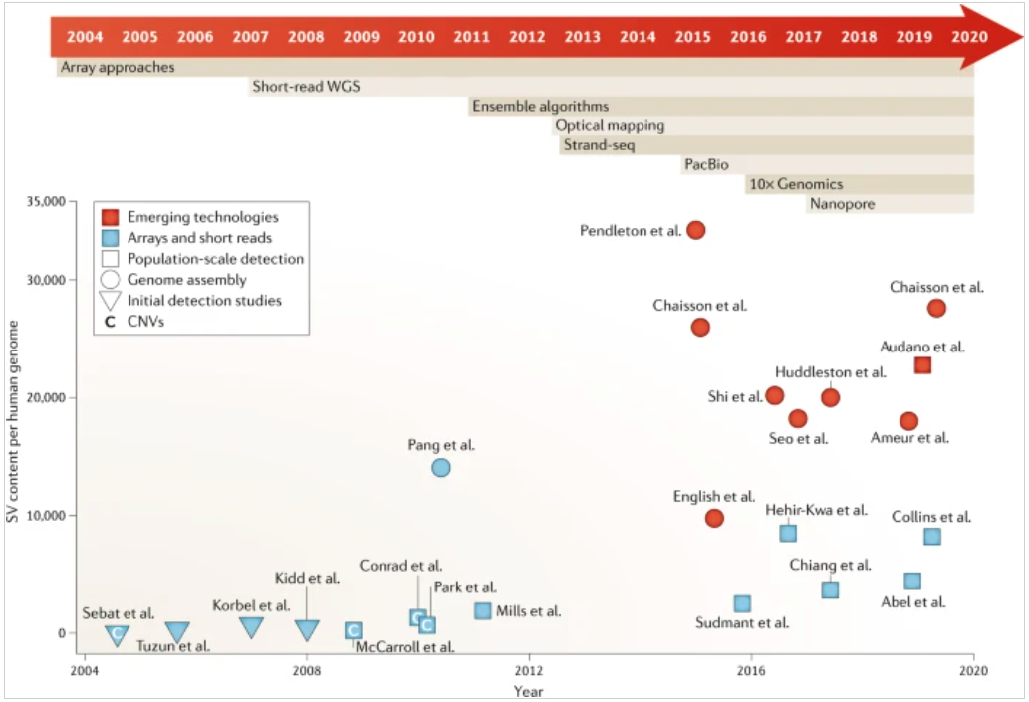
New Technologies Allow Identification of More SVs
Ho S. S., Urban A. E., and Mills R.E. Structural variation in the sequencing era. (2020). Nature Reviews Genetics. PMID: 31729472

Slide 10
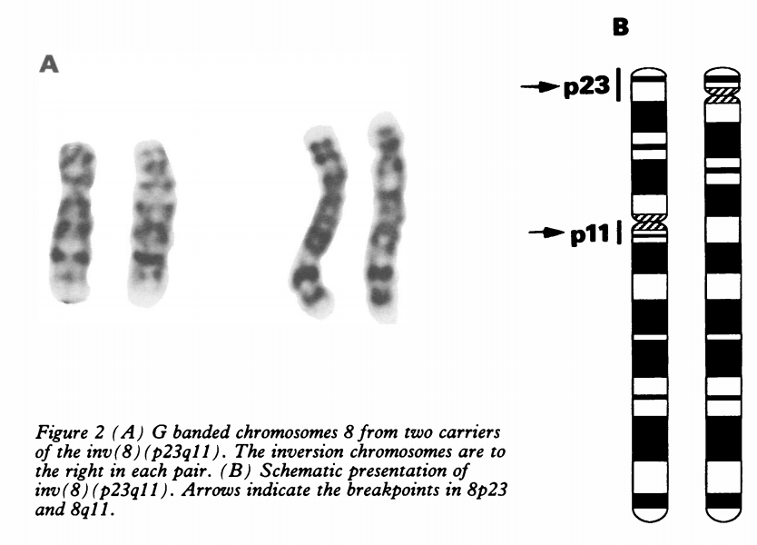
Chromosome Banding
The first structural variants were visible through a microscope!
It’s hard to see, but notice the banding between the left and right chromosomes don’t match!
Normal
Inverted
Boyd H. et al. Familial pericentric inversion inv(8)(p23q11). (1994). Journal of Medical Genetics. PMID: 8014967

Slide 11
Fiber Flourescent in situ Hybridization (FISH)
Single stranded DNA
Biotin Label
Hybridize…
Genomic DNA

Slide 12
Fiber FISH
Single stranded DNA
Biotin Label
Hybridize…
Genomic DNA
Single stranded DNA
Genomic DNA

Slide 13
Fiber FISH
Single stranded DNA
Biotin Label
Hybridize…
Genomic DNA
Bind Antibody…
Single stranded DNA
Genomic DNA

Slide 14
Fiber FISH
Single stranded DNA
Biotin Label
Hybridize…
Genomic DNA
Fluorophore
Bind Antibody…
… And glow!
Genomic DNA
Please note: this is a simple cartoon example. The reality is more complex!

Slide 15
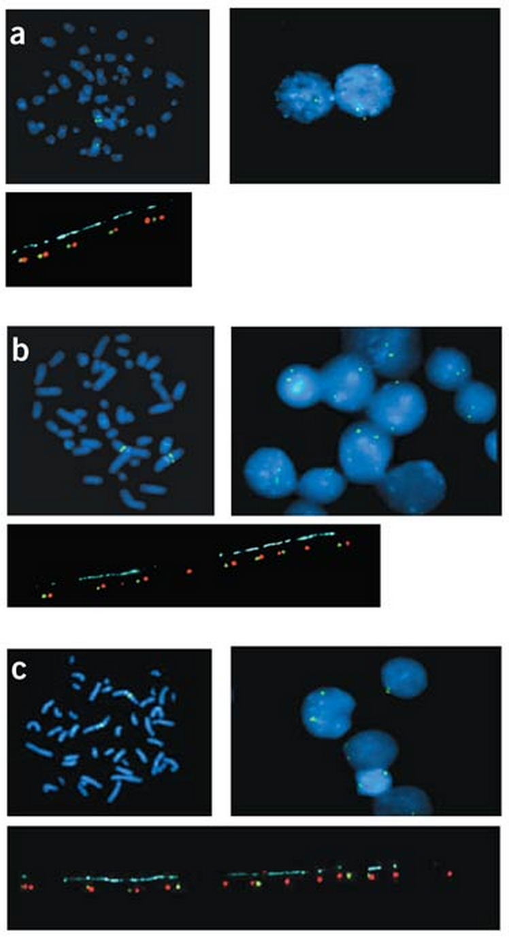
Fiber FISH
Can we identify regions in the human genome that have more/less copies in different individuals using fiber FISH?
Yes! One example is at the Amylase (AMY1) gene locus in humans.
Fewer Copies
Average Copies
More Copies
If we used SV types we just learned…
Deletion
Reference
Duplication
Iafrate A. J. et al. Detection of large-scale variation in the human genome. (2004). Nature Genetics. PMID: 15286789

Slide 16
Fiber FISH
The copy number of amylase varies based on population, and likely depends on the amount of starch (plant material) that a given population includes in their diet.
More Starch = Need More Amylase!
Perry G. H. et al. Diet and the evolution of human amylase gene copy number variation. (2007). Nature Genetics. PMID: 17828263
Novembre J., Pritchard J. K., Coop G. Adaptive drool in the gene pool. (2007). Nature Genetics. PMID: 17898775

Slide 17
Microarrays
SNP Microarray:
Cons
Low density – can only identify very large events (>100kbp)
Can be difficult to quality control
Can only find copy gain / loss (CNVs), no other SV types
Cannot identify SNVs (specialized)
Can only find copy gain / loss (CNVs), no other SV types
Pros
Relatively low cost –can analyze thousands of individuals at a time
Can analyze SNVs and CNVs at the same time
Can identify events invisible to Microarrays
Relatively low cost – can analyze thousands of individuals at a time
T
T
Patient DNA
Hybridize DNA to Silicon chip
Bind fluorophore specific to DNA base
T
G
Fragment DNA
Compare Intensity of green vs. red fluorophores
array Comparative Genome Hybridization (aCGH):
Bind fluorophore to entire DNA
Hybridize DNA to Silicon chip
Patient
Control
Both techniques hybridize DNA to a chip (silicon/glass/plastic/etc) and look for differences in fluorescence. They differ in how the fluorophore is bound…

Slide 18
Microarray & aCGH
Deletion!
Still used today to analyze large numbers of individuals for large Structural Variants (>100kbp) for relatively low cost:
UK Biobank has assessed 500k individuals with this approach. More than any other study!
Levy V. et al. Prenatal diagnosis by chromosomal microarray analysis. (2018). Fertility and Sterility. PMID: 29447663

Slide 19
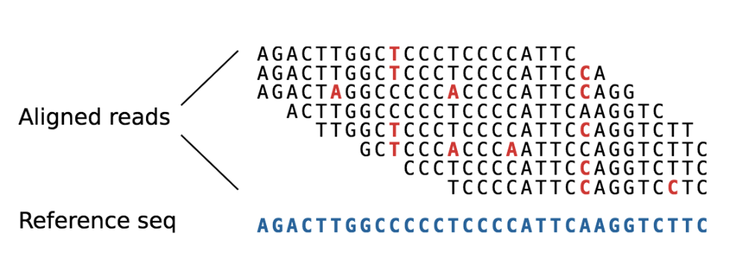
Short Read Sequencing for SV Detection
You learnt in the last module to identify SNVs using short read sequencing data:
SNV
One Read
You may also remember that these reads are sequenced in PAIRS…
Read 1:
100bp
Read 2:
100bp
One Read
Distance:
250bp
Original DNA Fragment: 450bp

Slide 20
Types of Structural Variant Evidence from Short Read Data
Pair Orientation / Distance:
Possible SV?
Read 1:
100bp
Read 2:
100bp
Read 1:
100bp
Read 2:
100bp
Distance:
250bp
Distance:
800bp
Reads align further/closer together
Split Reads:
Reads align in wrong direction
Read 1:
100bp
Entire read aligns to reference genome
Only red part aligns to reference genome
Read Depth:
4 read pairs align to same location
8 read pairs align to same location

Slide 21
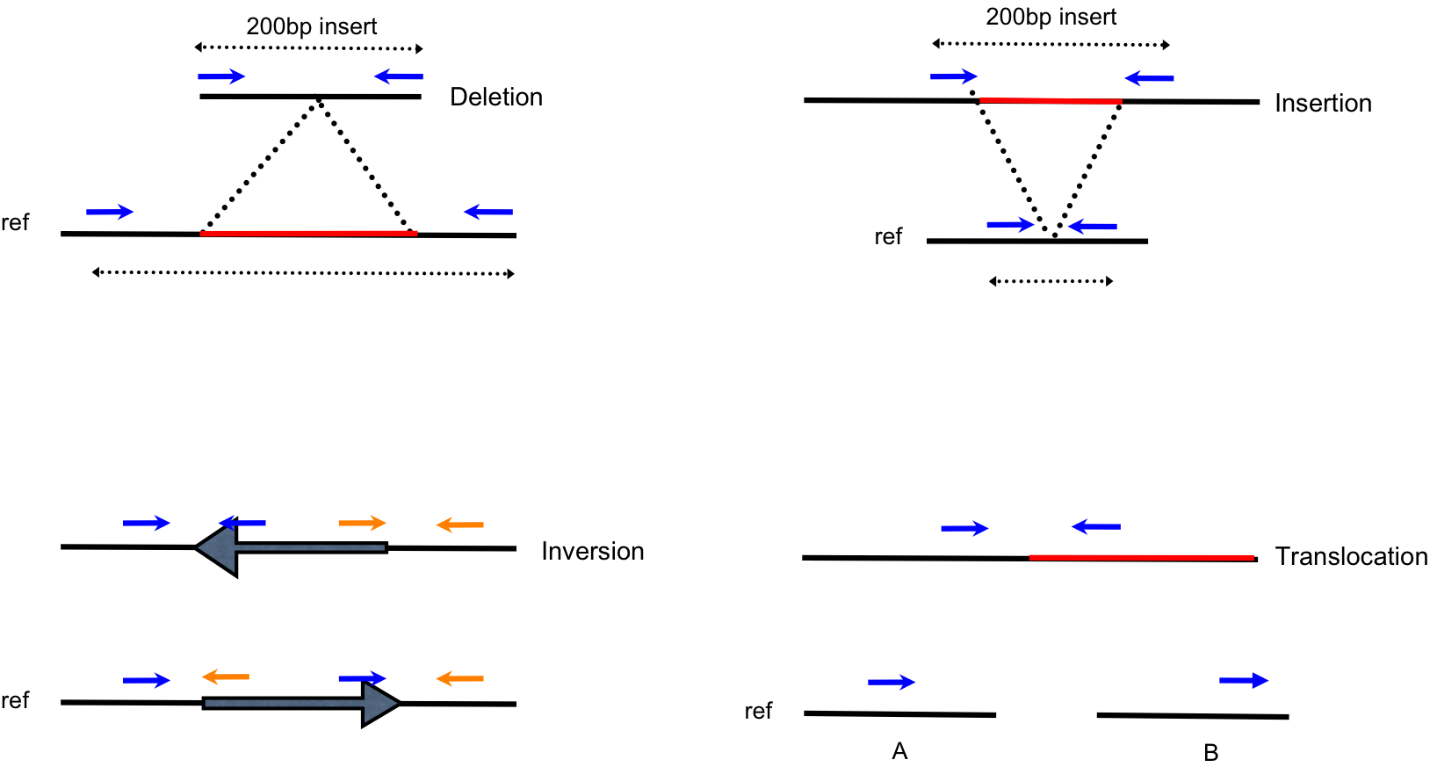
SV Types and Read Pair Information
We use how read pairs are oriented when they align to the reference to identify Structural Variants:
Read pairs too far apart:
Read pairs too close together:
Read pairs align next in the same direction:
Read pairs align to different chromosomes:
Reads align only partially to the reference:
Too many/few read pairs align:
Duplication
Insertion

Slide 22
Pair Orientation / Distance – More on non-reference retrotransposition events
Mobile Element Insertion
(MEI)
Mobile Element
Retrotransposons leave a unique read pair signature during alignment
Some read pairs align to the reference and the insertion (green/red)
Gardner, E. J., et al. The Mobile Element Locator Tool (MELT): Population-scale mobile element discovery and biology. (2017). Genome Research. PMID: 28855259

Slide 23
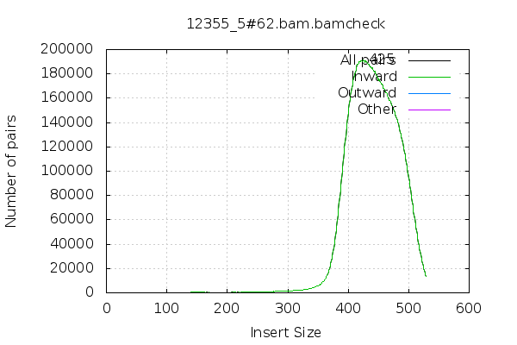
Pair Orientation / Distance – Fragment Size Distribution
Read 1:
100bp
Read 2:
100bp
Several types of structural variations (SVs)
Large Insertions/deletions
Inversions
Translocations
Read pair information used to detect these events
Paired end sequencing of either end of DNA fragment
Observe deviations from the expected fragment size
Presence/absence of read pairs
Distance:
250bp
Original DNA Fragment: 450bp

Slide 24
Pair Orientation / Distance – Fragment Size Distribution
Read 1:
100bp
Read 2:
100bp
Several types of structural variations (SVs)
Large Insertions/deletions
Inversions
Translocations
Read pair information used to detect these events
Paired end sequencing of either end of DNA fragment
Observe deviations from the expected fragment size
Presence/absence of read pairs
Distance:
250bp
Original DNA Fragment: 450bp
200bp

Slide 25
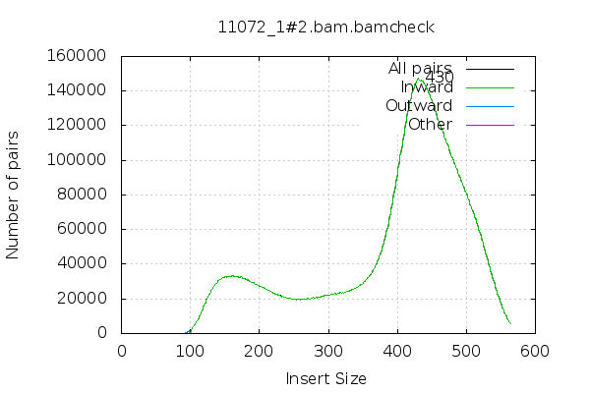
Pair Orientation / Distance – Fragment Size QC
Problem!

Slide 26
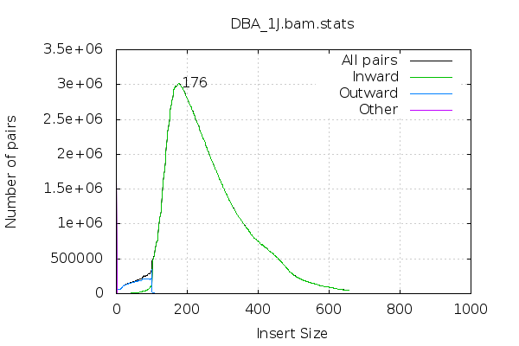
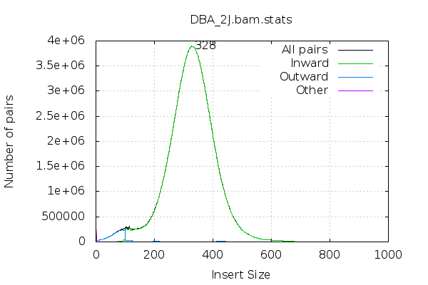
Pair Orientation / Distance – Fragment Size Distribution
DBA/1J
DBA/2J
DBA/1J fragment size distribution has larger range (~450bp) vs. DBA/2J (~250bp)
SV callers only consider read pairs discordant if they fall outside of the extremes of the fragment size distribution
Observed in DBA/1J that we had lower sensitivity to call SVs in the 300-500bp range compared to DBA/2J

Slide 27
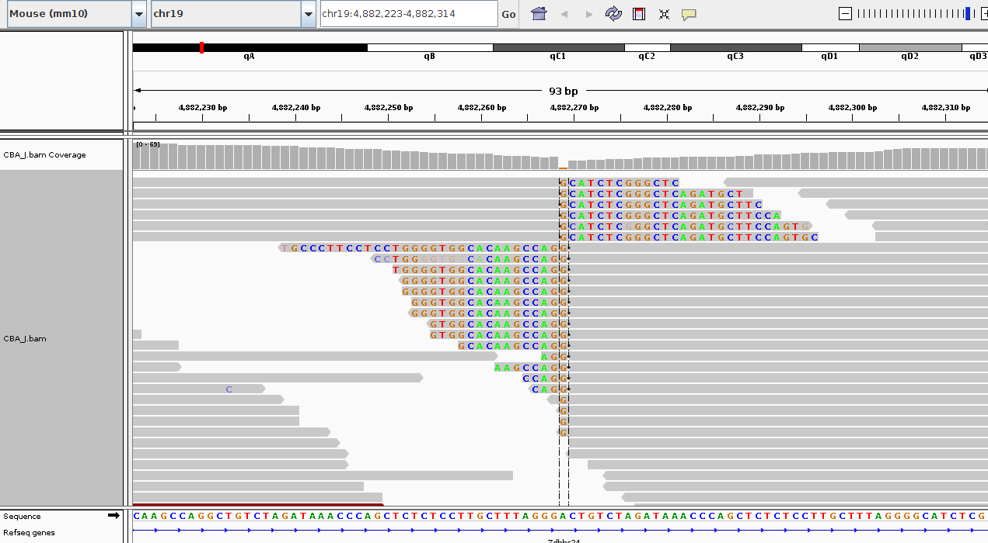
Split Reads
A split-read alignment is a single DNA fragment that spans a breakpoint and therefore does not contiguously align to the reference genome
Errors in the sequencing and alignment processes creates some ambiguity in the exact location of the breakpoint associated with a split-read alignment
Right click - view mismatch bases
View - preferences - alignments - show soft clipped bases

Slide 28
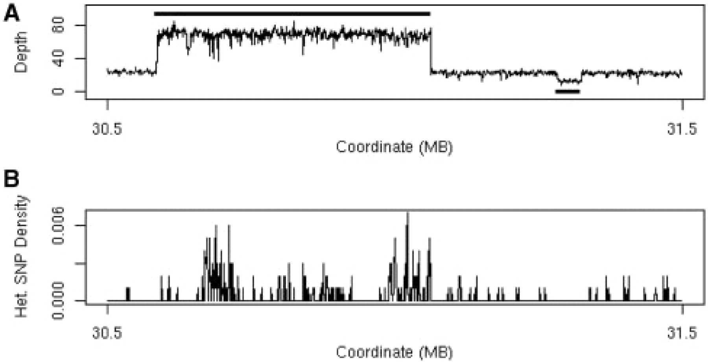
Read Depth
Fig. 1. (A) Plot of sequencing depth across a one megabase region of A/J chromosome 17 clearly shows both a region of 3-fold increased copy number (30.6–31.1 Mb) and a region of decreased copy number (at 31.3 Mb). The solid black line above the depth plot indicates the called copy number gain and the solid black line below the plot indicates the called copy number loss. (B) Plot of the heterozygous SNP rate for the same region showing the high number of apparent heterozygous SNPs associated with the copy number gain.
Simpson J. T. et al. Copy number variant detection in inbred strains from short read sequence data. (2009). Bioinformatics. PMID: 20022973

Slide 29
Identifying Structural Variants from Short Read Data
A number of tools have been developed that can find SVs from short read sequencing data
They use any combination of the three approaches we just discussed:
Pair Orientation / Distance
Split Reads
Depth
We are now going to talk about two specific callers that you will have a chance to use yourself during the practical exercise:
BreakDancer: uses Pair Orientation / Distance
LUMPY: uses Pair Orientation / Distance, Split Reads, and Depth
Please note! There are many additional tools that have been developed to identify SVs, we are just looking at two today.

Slide 30
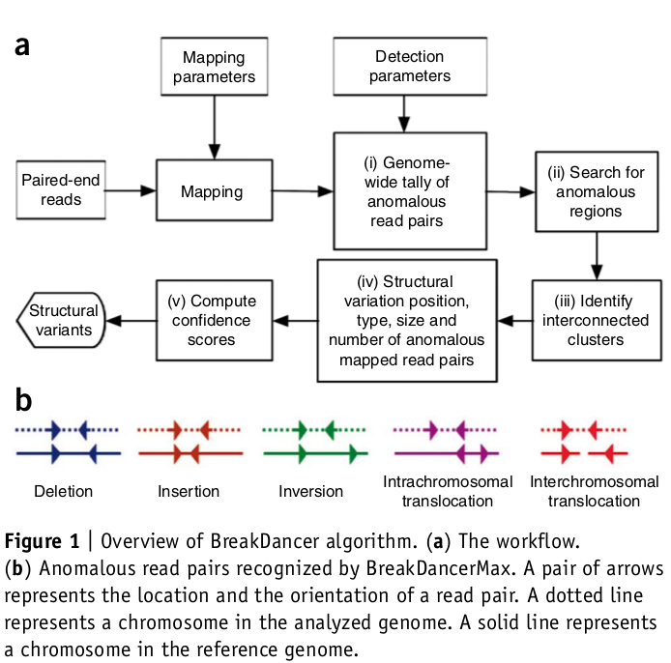
BreakDancer: Read pairs
Identifies deletions, insertions, inversions and intrachromosomal and interchromosomal translocations
Input: BAM file
Algorithm:
Analyse a subset of reads from each sequencing library (determine mean and standard deviation of fragment size)
Walk along each chromosome to identify all of the anomalous read pairs (a). Identify interconnected clusters.
Assign anomalous clusters into categories (b)
Output
Text with one SV event per line
Filter by: minimum number of reads, quality score, type of SV
Chen K et al. BreakDancer: an algorithm for high-resolution mapping of genomic structural variation. (2009) Nature methods. PMID: 19668202

Slide 31
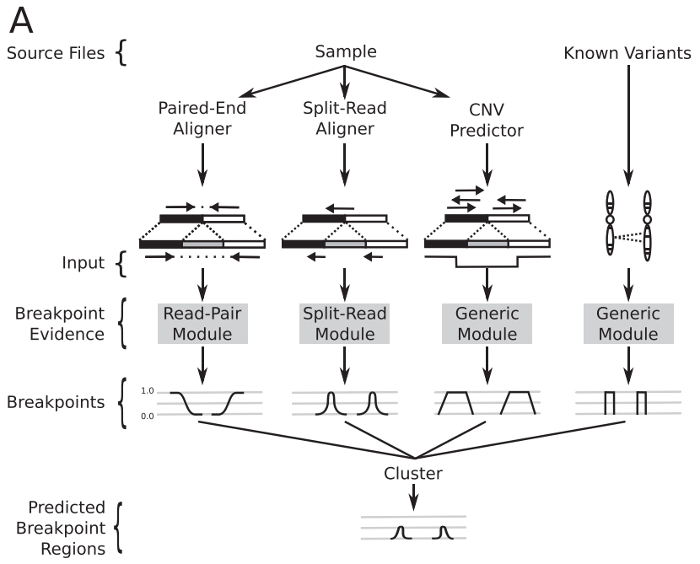
LUMPY: Read pairs + split reads + depth
Any number of alignment signals can be integrated into a single discovery process
Read pairs, split-reads, depth, user supplied evidence
Distinct modules that map signals from each alignment evidence type to the common probability interval pair.
Evidence from the different alignment signals is mapped to breakpoint intervals, overlapping intervals are clustered and the probabilities are integrated
Layer R. M. et al. LUMPY: a probabilistic framework for structural variant discovery. (2014). Genome Biology. PMID: 24970577

Slide 32
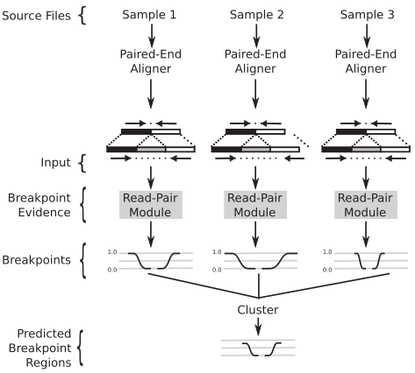
LUMPY: multi-signal and multi-sample workflows
Layer R. M. et al. LUMPY: a probabilistic framework for structural variant discovery. (2014). Genome Biology. PMID: 24970577

Slide 33
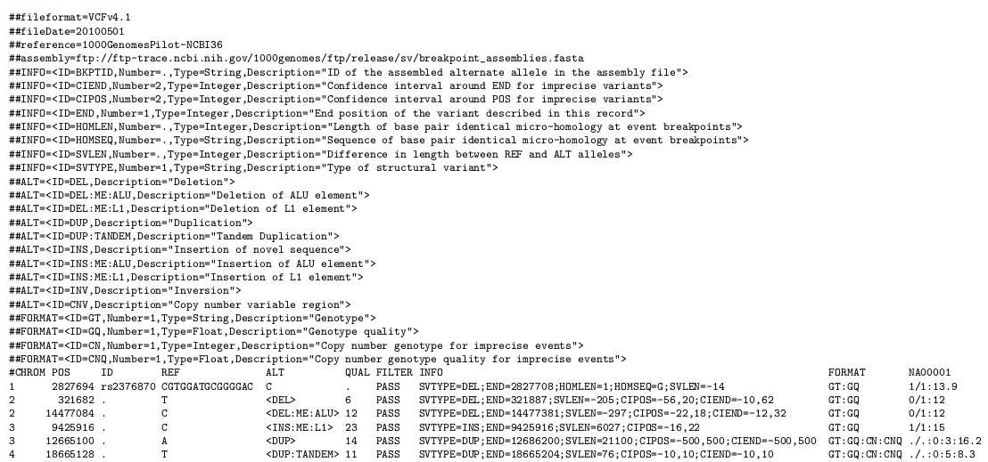
VCF for SVs
Danecek P. et al. The variant call format and VCFtools. (2011). Bioinformatics. PMID: 21653522

Slide 34
VCF for SVs
Danecek P. et al. The variant call format and VCFtools. (2011). Bioinformatics. PMID: 21653522

Slide 35
VCF for SVs
Danecek P. et al. The variant call format and VCFtools. (2011). Bioinformatics. PMID: 21653522

Slide 36
SV Visualisation
Structural variation visualisation can be more challenging than SNPs and indels
Inspect several hundred base pairs or multiple kbp
Analyse complicated read pair patterns to determine type of SV and sources of error
Look for soft clipped bases for breakpoint accuracy
Many NGS visualisation software packages exist
The Integrative Genomics Viewer (IGV) from Broad institute is a popular and easy to use visualisation software
Requires BAM file and fasta file of the reference genome
Viewing settings need to be tailored for the type of SV being visualised (see notes below each screenshot)
Thorvaldsdóttir H. et al. Integrative Genomics Viewer (IGV): high-performance genomics data visualization and exploration. (2013). Brief. Bioinformatics. PMID: 22517427

Slide 37
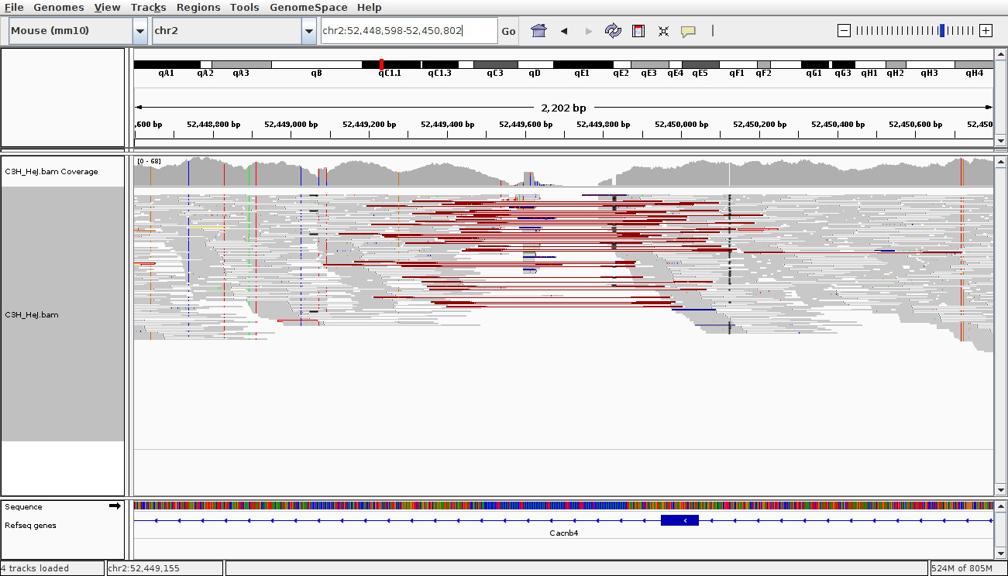
IGV - Deletion
Right click - Squished

Slide 38
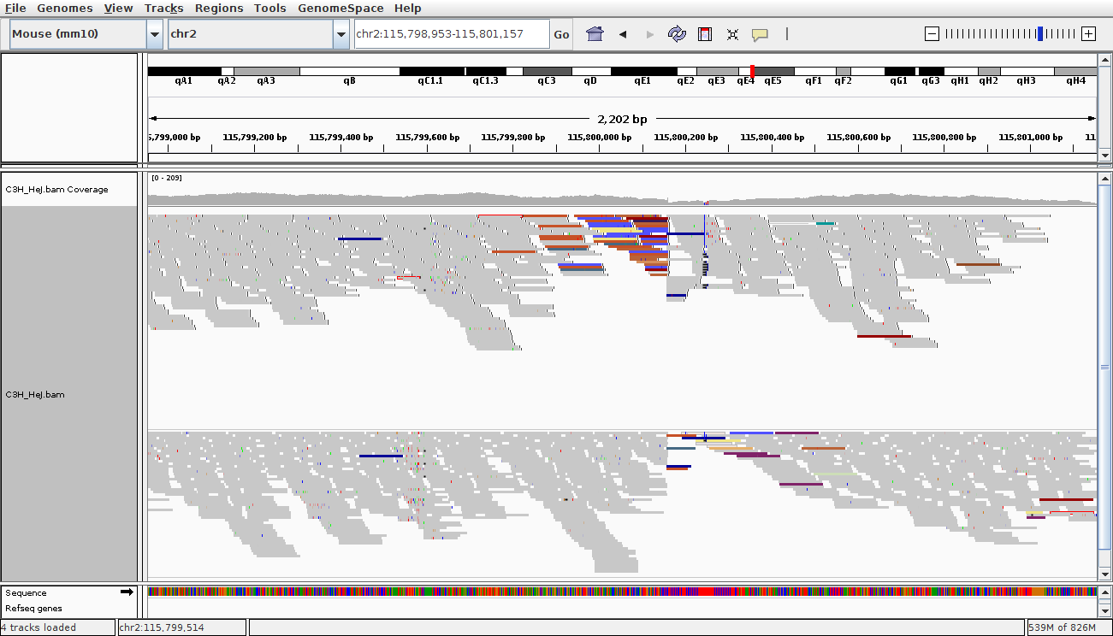
IGV - Insertion
Right click - group alignments by 'read strand'

Slide 39
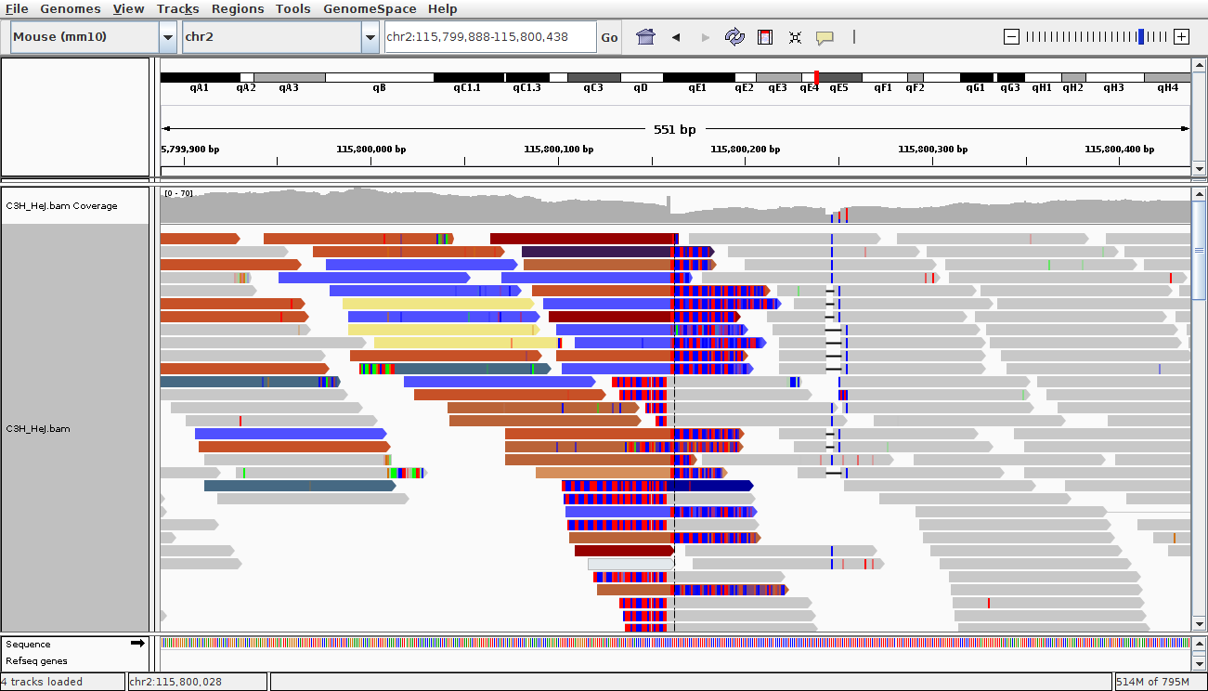
IGV - Insertion (zoomed)
Right click - view mismatch bases
View - preferences - alignments - show soft clipped bases

Slide 40


SVs and long read sequencing
Single molecule sequencing of large DNA fragments
Platforms: Oxford nanopore and Pacific Biosciences
Read lengths routinely 10-20Kbp
Longer than most common transposable element repeats
What does it mean for SV detection? Span both breakpoints with single read
Some new challenges
Reads are error prone, 5-20% error
Expensive!
Short Read:
Read 1:
100bp
Read 2:
100bp
Distance:
250bp
Original DNA Fragment: 450bp
Read 1:
10kbp+
Long Read:
Original DNA Fragment: 10kbp+

Slide 41
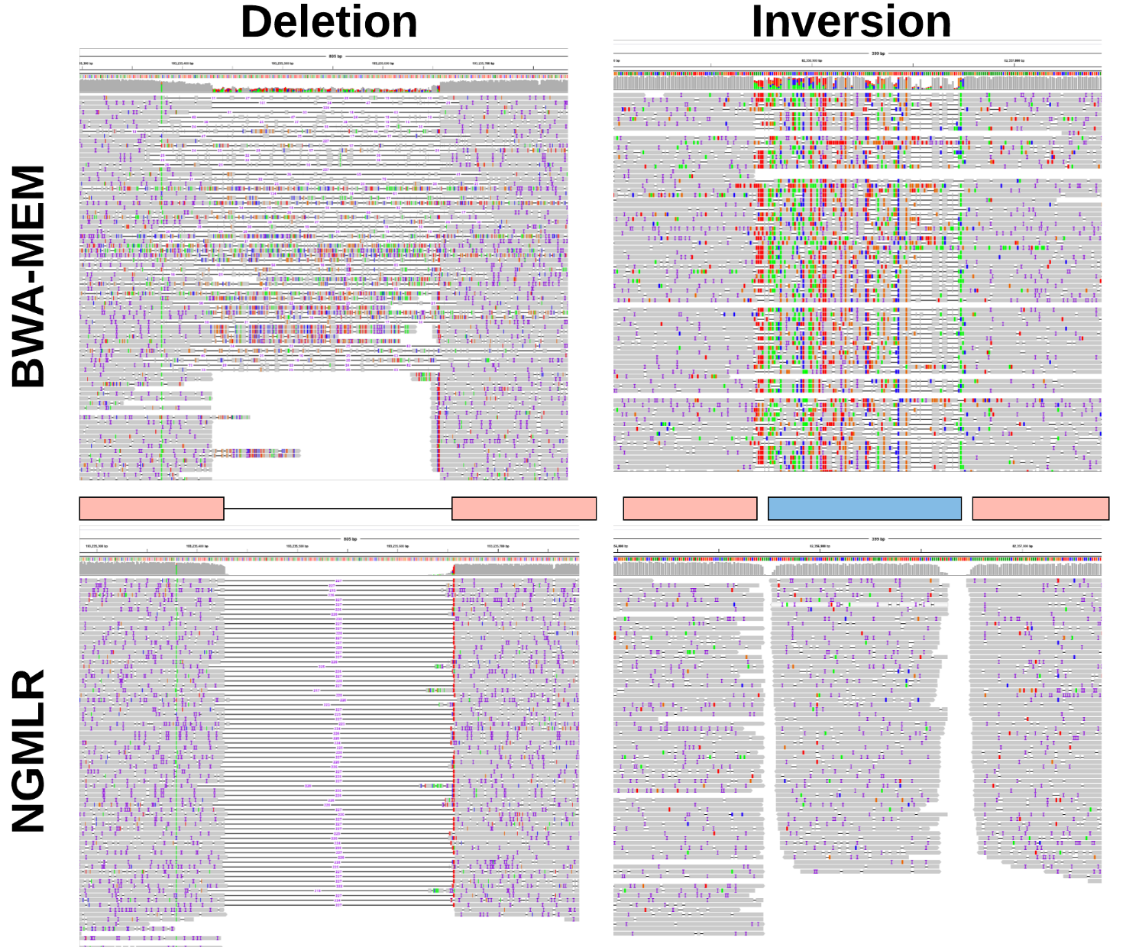
Alignment challenges
Sedlazeck F. et al. Accurate detection of complex structural variations using single-molecule sequencing. (2018). Nature Methods. PMID: 29713083

Slide 42
Alignment challenges
Sedlazeck F. et al. Accurate detection of complex structural variations using single-molecule sequencing. (2018). Nature Methods. PMID: 29713083

Slide 43
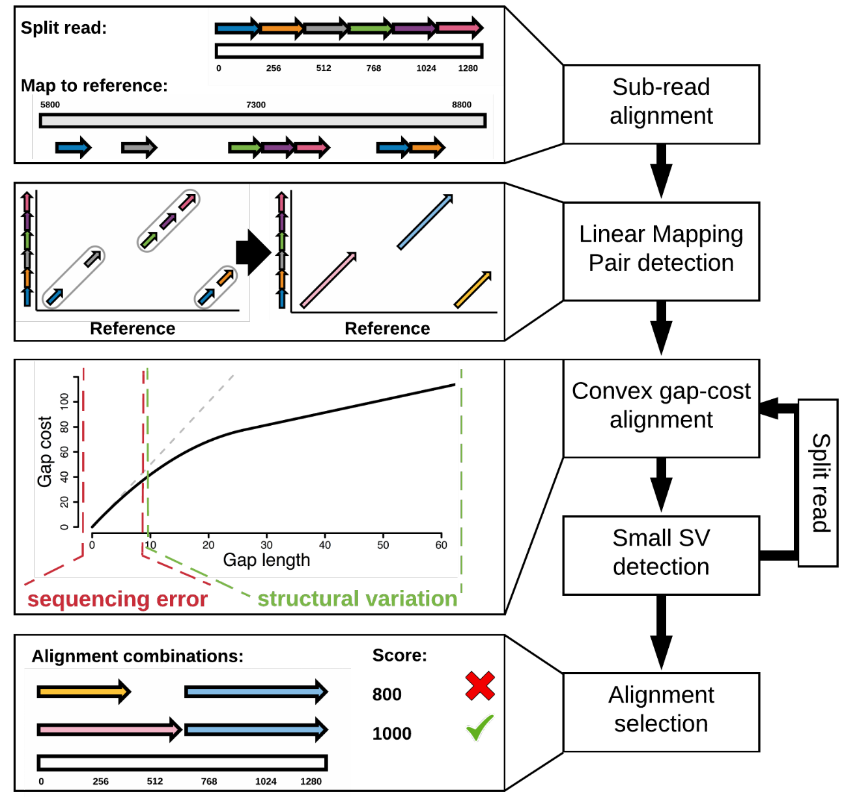
coNvex Gap-cost alignMents for Long Reads (NGMLR)
NGMLR - aligner specifically designed for long reads
Convex scoring model
Extending an indel is penalized proportionally less the longer the indel is
Sedlazeck F. et al. Accurate detection of complex structural variations using single-molecule sequencing. (2018). Nature Methods. PMID: 29713083

Slide 44
Alignment challenges
Sedlazeck F. et al. Accurate detection of complex structural variations using single-molecule sequencing. (2018). Nature Methods. PMID: 29713083

Slide 45
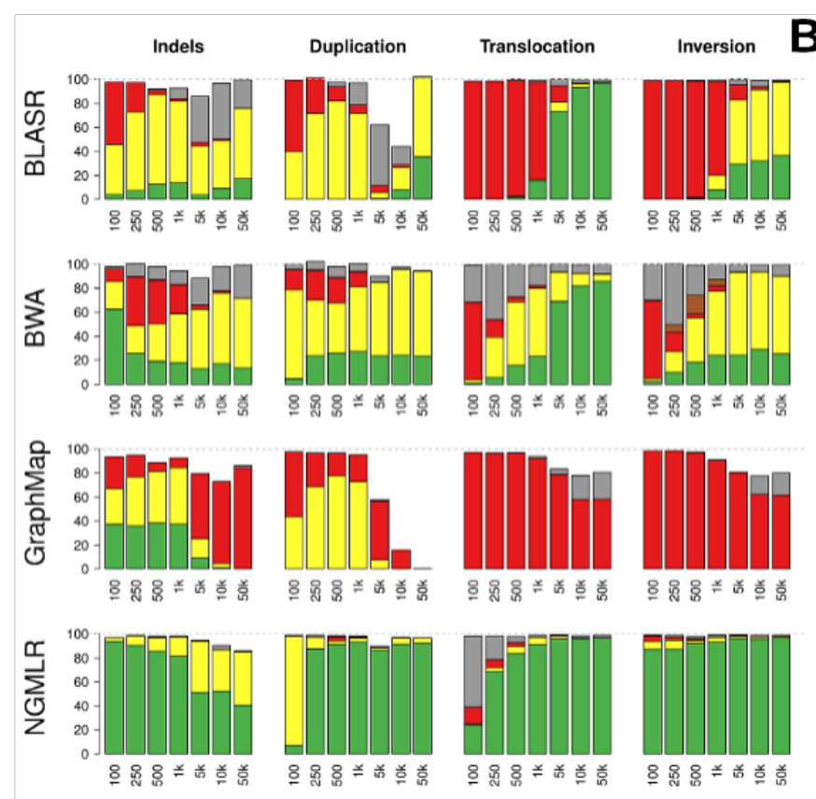
Comparison of aligners (simulated data)
Alignment Status:
Precise
Indicated
Forced
Unaligned reads
Trimmed but not aligned through the SV
Sedlazeck F. et al. Accurate detection of complex structural variations using single-molecule sequencing. (2018). Nature Methods. PMID: 29713083
Notes:
For read
alignments, we simulated PacBio-like (a) and Oxford Nanopore-like reads (c), and
distinguish between: precise (green), indicated (yellow), forced (red), unaligned reads
(white), or trimmed but not aligned through the SV (grey).

Slide 46
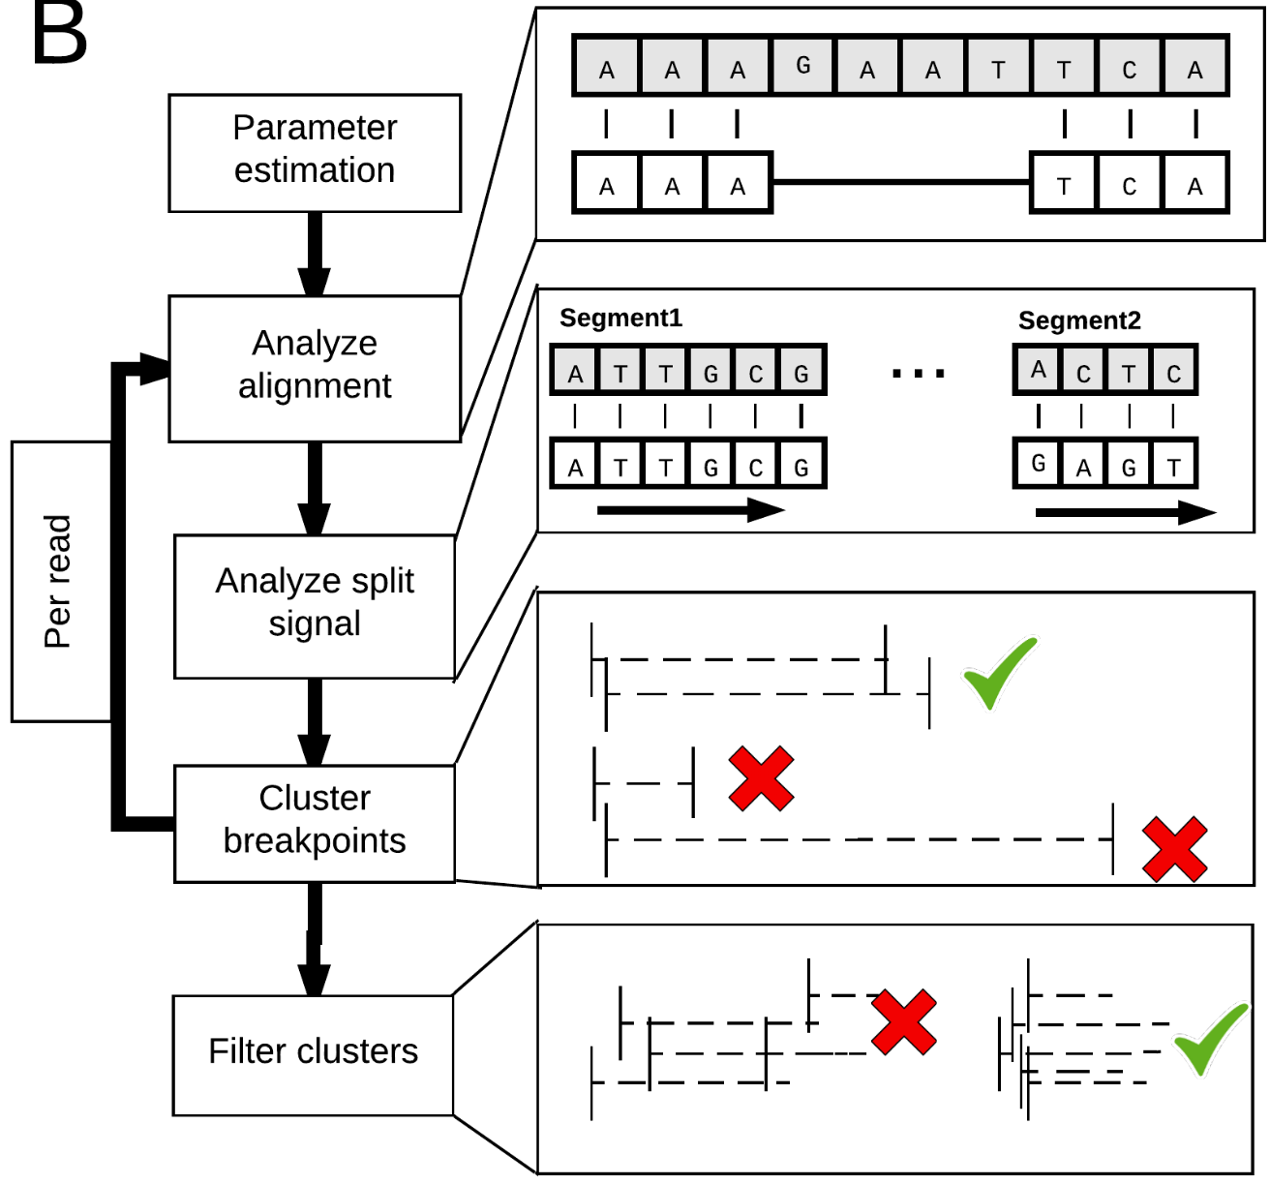
Sniffles
SV detection from long read alignments
Sedlazeck F. et al. Accurate detection of complex structural variations using single-molecule sequencing. (2018). Nature Methods. PMID: 29713083

Slide 47
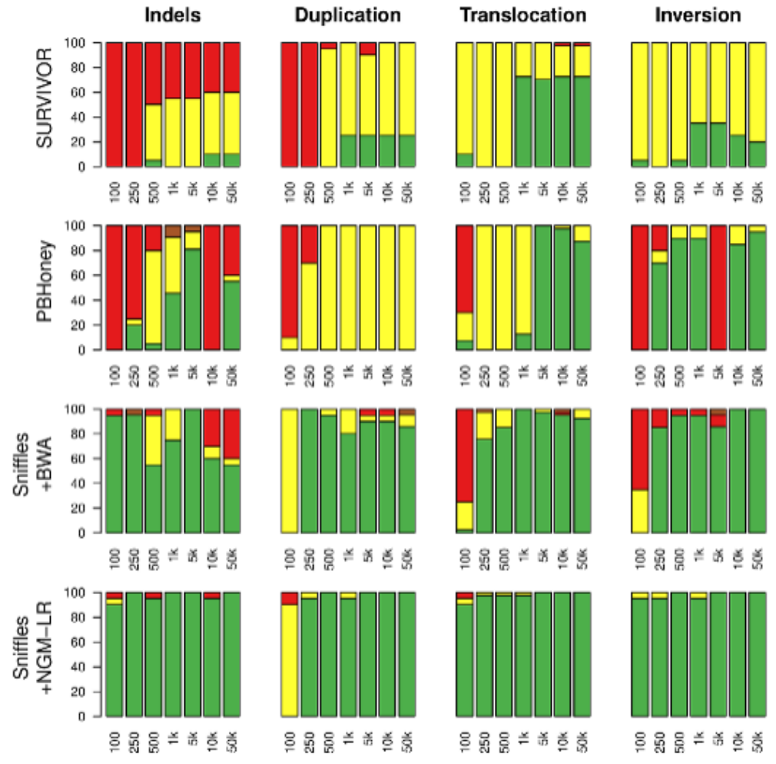
Sniffles performance
Alignment Status:
Precise
Indicated
Forced
Unaligned reads
Trimmed but not aligned through the SV
Sedlazeck F. et al. Accurate detection of complex structural variations using single-molecule sequencing. (2018). Nature Methods. PMID: 29713083

Slide 48
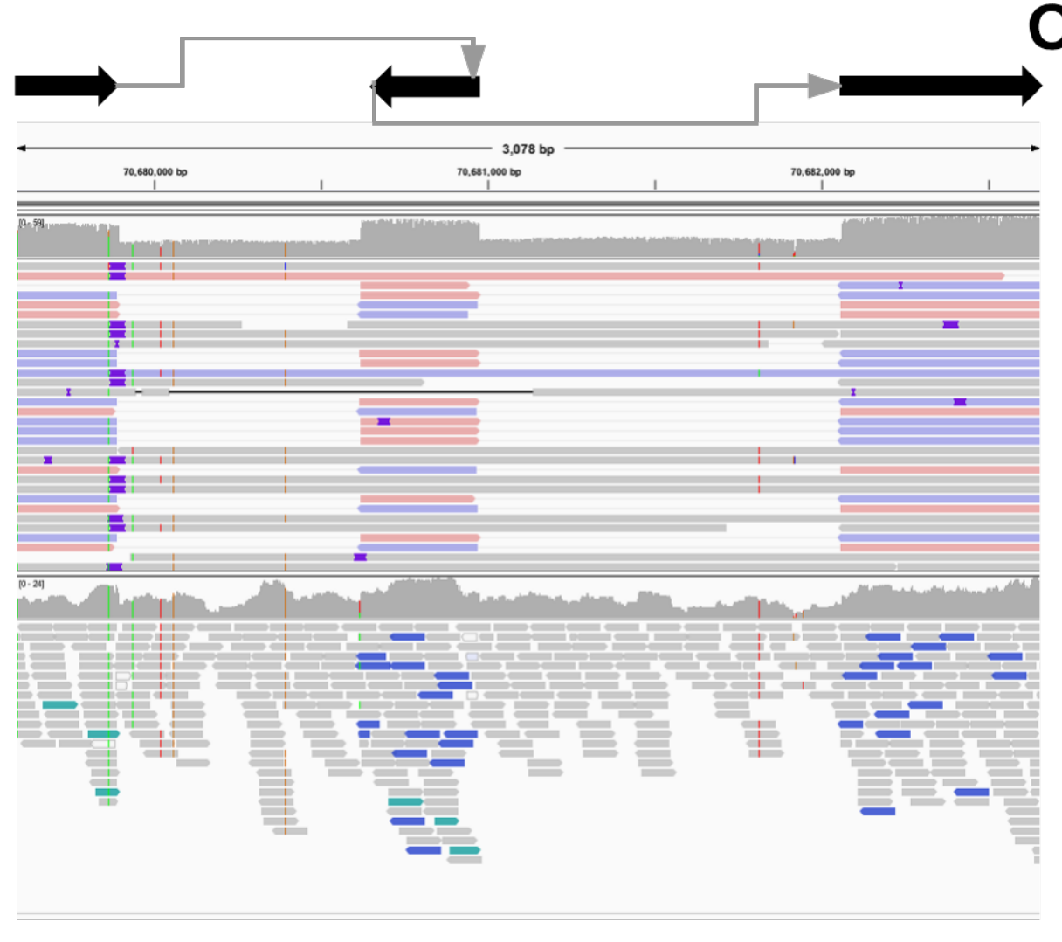
Complex SVs - Long reads
NGLMR
Illumina (BWA-mem)
3kb region: two deletions flanking an inverted sequence

Slide 49
Complex SV Examples in Diagnostic Sequencing
Phenotype:
Phenotype:
Coffin-Siris syndrome; Atrial septal defect; Cleft soft palate
Tonic-clonic seizures; Intellectual disability; Learning difficulties
Size:
Size:
~23 Million Base Pairs (23 Mbp)
~2 Million Base Pairs (2Mbp)
Both were associated with patient phenotype!
Sanchis-Juan A. et al. Complex structural variants in Mendelian disorders: identification and breakpoint resolution using short- and long-read genome sequencing. (2018). Genome Medicine. PMID: 30526634

Slide 50
New Technologies Allow Identification of More SVs
Ho S. S., Urban A. E., and Mills R.E. Structural variation in the sequencing era. (2020). Nature Reviews Genetics. PMID: 31729472

Slide 51
The Future of Structural Variation – Short Reads
The gnomAD SV project
Collins RL et al. assessed >14,000 human genomes from a diverse set of populations for Structural Variation with short read technology as part of the gnomAD project.
They identified 433,371 SVs.
Collins, R. L. et al. A structural variant reference for medical and population genetics. (2020). Nature. PMID: 32461652

Slide 52
The Future of Structural Variation – Long Reads
The Human Genome Structural Variation Consortium
Ebert P. et al. used long read sequencing to identify SVs in 64 humans from around the world.
They identified a total of 107,590 SVs
Ebert P. et al. Haplotype-resolved diverse human genomes and integrated analysis of structural variation. (2021). Science. PMID: 33632895

Slide 53
The Future of Structural Variation – Which Technology?
Ebert P. et al. Haplotype-resolved diverse human genomes and integrated analysis of structural variation. (2021). Science. PMID: 33632895
Notes:
Blue is what we find with long reads
Orange is what we find with short reads

Slide 54
The Future of Structural Variation – Which Technology?
Long Reads or Short Reads?
Long Reads are still expensive
Short Reads don’t work well at some size ranges
So do we…
… Sequence small number of samples really well (long reads), or…
… large number of samples adequately (short reads)?
Or: How do we best trade-off number of samples vs. accuracy of SV identification…?
Ebert P. et al. Haplotype-resolved diverse human genomes and integrated analysis of structural variation. (2021). Science. PMID: 33632895
Notes:
Blue is what we find with long reads
Orange is what we find with short reads

Slide 55
The Future of Structural Variation – Which Technology?
Do we actually need all of those structural variants that long read sequencing finds…?
These are where variants which cause disease are found (currently!)
“[split read sequencing] captures virtually all high-quality deletions derived from [long read sequencing] assembly in the regions of the genome that encompass over 95% of currently annotated coding sequence in genes with existing evidence for dominant-acting pathogenic mutations from OMIM. We therefore anticipate that a minority of “unsolved” cases will be explained by novel and readily interpretable deletions that can be captured by [long read sequencing] but remain cryptic to [split read sequencing] in known disease-associated genes…
… However, given that the most highly repetitive regions of the genome have been traditionally inaccessible in human disease studies, it is anticipated that new disease-associated genes and sequences will emerge as functional annotation of these repetitive sequences and duplicated genes continues to improve.”
Zhao X et al. Expectations and blind spots for structural variation detection from long-read assemblies and short-read genome sequencing technologies. (2021). AJHG. PMID: 33789087

Slide 56
Computer exercises
Trivia questions about a VCF output file from the LUMPY SV caller.
http://www.genomebiology.com/2014/15/6/R84
Use the BreakDancer software package to call structural variants on a yeast sample that was paired-end sequenced on the illumina Hiseq.
Use the LUMPY software package to call structural variants on a yeast sample that was paired-end sequenced on the illumina Hiseq.
Call SVs using the Sniffles caller on a yeast sample that was sequenced on the Pacbio platform.
Introduction to BEDtools for doing regional comparisons over genomic co-ordinates.

